Slide 1
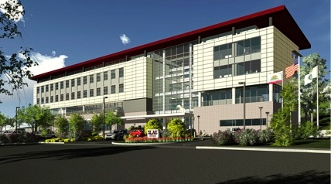
Welcome SUSB
Presented By
SLAC and Hensel Phelps

Slide 2
SUSB
Offices
Conference Tower
Auditorium

Slide 3
Major HVAC Systems
Conference Room Tower
AHU supplying VAVs and fan coils with cooled air Heat provided by reheat coils within the VAVs
Auditorium
AHU supplying VAVs with cooled air Heat provided by reheat coils within the VAVs
Office Tower
natural ventilation, radiant floor, chilled sails, operable windows, ceiling fans
Exhaust System –
bathrooms, kitchen, break rooms

Slide 4
Room Lighting and Fan Controller
The Fan controller operates with a bottom mounted On/Off switch.
The fan blade direction is reversible by pushing the REV button.
You may select LOW, MEDIUM, or HIGH fan speeds.
The LIGHT (green) button serves no function.
The top light switch may need to be pressed as you enter your office to turn on your lights.
The up arrow/Down Arrow buttons raise and lower lighting levels.
The lights will automatically go off if the area is unoccupied.

Slide 5
Chilled Sails

Slide 6
Ceiling Fans

Slide 7
Ceiling Fan Tips
Try the different settings.
Have the fan blow up in the cooler months on a low speed
Have the fan blow down in the warmer months at a medium to high speed.

Slide 8
Lighting control
The lighting is also a step forward in green technology.
We have active day-lighting controls that sense the amount of natural light and adjust the artificial light accordingly.
Because of this you may notice the lights seem to control themselves at times as they adjust to provide the best scenario for natural light and energy efficiency.
The lighting is also on occupancy sensors and will turn off if the area is unoccupied.

Slide 9
Day-lighting Sensor

Slide 10
Occupancy Sensor

Slide 11
What to Expect
The Building is designed to maintain 68-78 (+/- 2) degrees.
Many areas have ceiling fans that are operated by the user.
There are windows you can open! Fresh Air! Please close your window at the end of your day.
Some upper windows are equipped with automated motors controlled by the BMS.
The radiant floor systems and chilled sails are automated by the BMS.

Slide 12
What to Expect
The Building has active day lighting controls. This means the lights will automatically dim as the natural light coming in gets brighter.
There are occupancy sensors that turn the lights off when they don’t sense a presence in the room.
The operating hours for the building are 6am to 6pm.

Slide 13
Audio Visual
Each conference room will have a wall mounted control panel and a tabletop touch panel.
The extra large conference room (2002) will also utilize an iPad Air for room control.
The wall mounted panel will control:
-Power to monitors
-Volume
-Source selection
The touch panel located on the table will control
Monitors on/off, (system wake up/sleep)
Camera
Volume
Source Selection

Slide 14
Audio Visual
Source Selection
To display the CPU or AirMedia, you will select the designated source option from either the wall mounted control panel, or the tabletop touch panel.
To display/share laptop content, connect your device (Laptop) to the HDMI or VGA tabletop connection, then select the designated source option from either the wall mounted control panel or the tabletop touch panel.

Slide 15
Who Do I Call?
For all calls and concerns dial 8901 and submit a Facilities Service Request.
Your Building Manager is Mark Wise
You will be provided with a packet of more detailed information regarding your new and exciting workspace when you move in.

Slide 16
QUESTIONS?

